Slide 1

Moving the Needle in Rowhammer Defense with a Minimalist Approach
Moinuddin Qureshi
(moin@gatech.edu)
Keynote, DRAMSec-2025

Slide 2
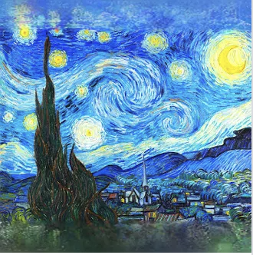

Painting vs. Sculpture?
A painting is complete when nothing more needs to be added
A sculpture is complete when nothing more can be removed

Slide 3

The Rowhammer Saga
DRAM Scaling for Increased Capacity
More Inter-Cell Interference
DRAM
(old)
DRAM
(new)
Notes:
- With DRAM Scaling for increased capacity, DRAM cells are so close that activity on cells in one DRAM row causes charge leakage from cells in neighboring rows.
Rowhammer attacks exploit this phenomenon by accessing a DRAM row rapidly in a short window of time, that ends up causing bit-flips in neighboring rows. Essentially, this allows an adversarial software to flip bits in memory without accessing them.
Adversarial software can gain kernel-level privileges, by tampering the page-tables [Orig], or sensitive binaries like the sudo binary [Another-Flip], and even infer data in neighboring rows based on whether they flip or not [RamBleed].

Slide 4

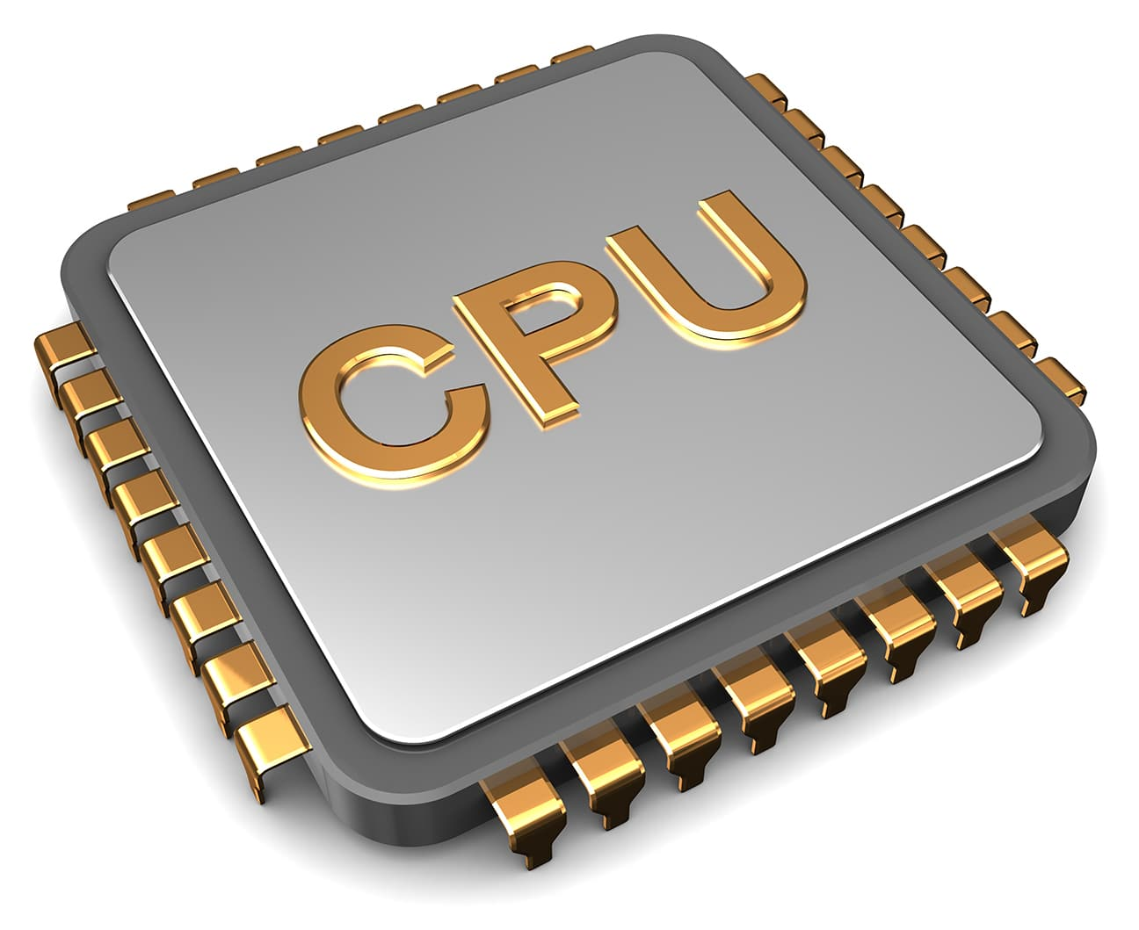
Rowhammer Attacks
DRAM Scaling for Increased Capacity
More Inter-Cell Interference
Rowhammer Attack
DRAM
(old)
Row of Cells (8KB)
Aggressor Row
Row
Rapid
Accesses
Row
Victim Row
Aggressor Row
Row
DRAM
(new)
DRAM
Bit-Flips in Neighboring Rows
Notes:
- With DRAM Scaling for increased capacity, DRAM cells are so close that activity on cells in one DRAM row causes charge leakage from cells in neighboring rows.
Rowhammer attacks exploit this phenomenon by accessing a DRAM row rapidly in a short window of time, that ends up causing bit-flips in neighboring rows. Essentially, this allows an adversarial software to flip bits in memory without accessing them.
Adversarial software can gain kernel-level privileges, by tampering the page-tables [Orig], or sensitive binaries like the sudo binary [Another-Flip], and even infer data in neighboring rows based on whether they flip or not [RamBleed].

Slide 5
Rowhammer Attacks
Rowhammer Attack
loop:
mov (X), %eax
mov (Y), %ebx
clflush (X)
clflush (Y)
mfence
jmp loop
Row of Cells (8KB)
Aggressor Row
Row
Rapid
Accesses
Row
Victim Row
Aggressor Row
Row
Software Adversary Can Flip Bits in Page Tables &
Gain Kernel Privileges (Take Over a System)
DRAM
Bit-Flips in Neighboring Rows
[Seaborn+, Blackhat’15]
Notes:
- With DRAM Scaling for increased capacity, DRAM cells are so close that activity on cells in one DRAM row causes charge leakage from cells in neighboring rows.
Rowhammer attacks exploit this phenomenon by accessing a DRAM row rapidly in a short window of time, that ends up causing bit-flips in neighboring rows. Essentially, this allows an adversarial software to flip bits in memory without accessing them.
Adversarial software can gain kernel-level privileges, by tampering the page-tables [Orig], or sensitive binaries like the sudo binary [Another-Flip], and even infer data in neighboring rows based on whether they flip or not [RamBleed].

Slide 6
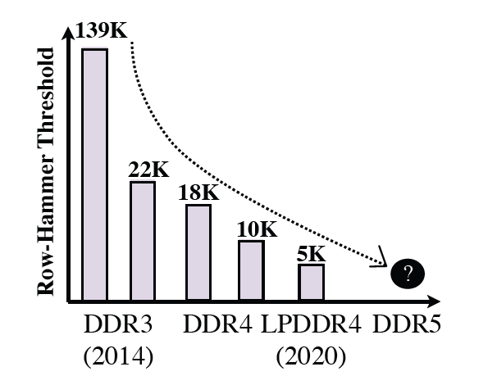
Rowhammer is Getting Worse!
Rowhammer Threshold: TRH-S (Single Sided) and TRH-D (Double-Sided)
30x Reduction in TRH in 8 years!
Solutions must tolerate not only current TRH but future TRH
Notes:
- With DRAM Scaling for increased capacity, DRAM cells are so close that activity on cells in one DRAM row causes charge leakage from cells in neighboring rows.
Rowhammer attacks exploit this phenomenon by accessing a DRAM row rapidly in a short window of time, that ends up causing bit-flips in neighboring rows. Essentially, this allows an adversarial software to flip bits in memory without accessing them.
Adversarial software can gain kernel-level privileges, by tampering the page-tables [Orig], or sensitive binaries like the sudo binary [Another-Flip], and even infer data in neighboring rows based on whether they flip or not [RamBleed].

Slide 7
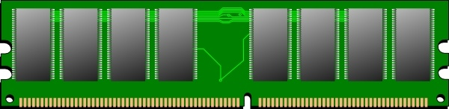
Typical Mitigation for Rowhammer
Track Aggressor Rows
Mitigative Action
1
2
Victim Row
Refresh
Aggressor Row
Victim Row
DRAM
Tracking can be done at Memory Controller (MC) or In-DRAM
(In-DRAM mitigation can solve DRAM problem within DRAM)

Slide 8
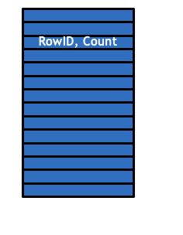
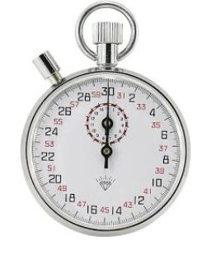
What is In-DRAM Mitigation?
Track Aggressor Rows
Mitigative Action
1
2
Victim Row
Refresh
Aggressor Row
Victim Row
DRAM
DDR4: 4-16 Entries
Borrow Time from REF
In-DRAM Mitigation needs Space (Tracking) and Time (Victim Refresh)

Slide 9
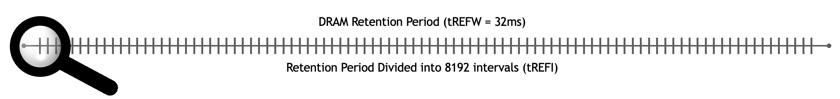
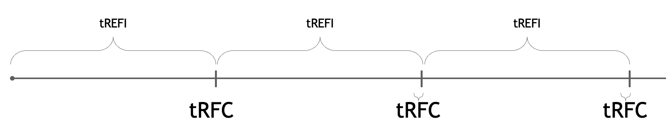
Refresh 101
~73 ACTs
REF
Refresh 8-16
DRAM Rows
Check Tracker, Do
RH Mitigation
In-DRAM borrows time from “REF” to perform RH mitigation

Slide 10
What About the In-DRAM Tracker?
Optimal Trackers
Low-Cost Tracker
4-20 entries
(TRR, DSAC, PAT)
ProTRR, Mithril
(100-1000s entries)
Optimal trackers incur high SRAM overheads. Low-Cost Trackers Secure?

Slide 11
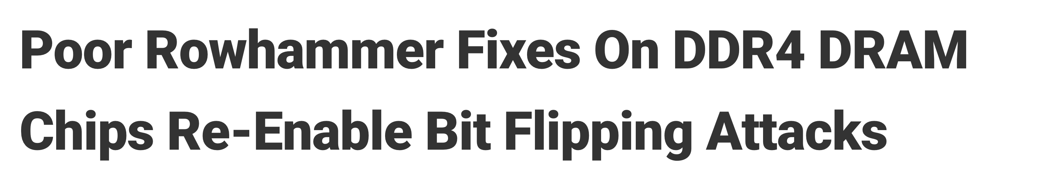
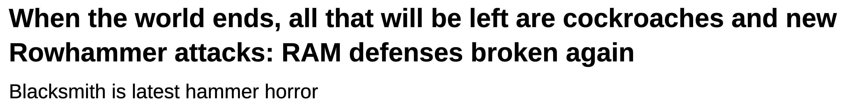
Low-Cost In-DRAM Trackers Broken!
Targeted Row Refresh (TRR) in DDR4 (2015)
Track Aggressor Rows
Mitigative Action
1
2
TRResspass Breaks TRR Tracker [Frigo+, SP’20]
Victim Row
Refresh
Aggressor Row
Source: The Hacker News
Victim Row
Blacksmith Attack: All DDR4 DRAM Vulnerable [Jattke+, SP’22]
DRAM
Source: The Register
DRAM Industry: Our TRR was broken, so ALL low-cost TRR will be broken

Slide 12
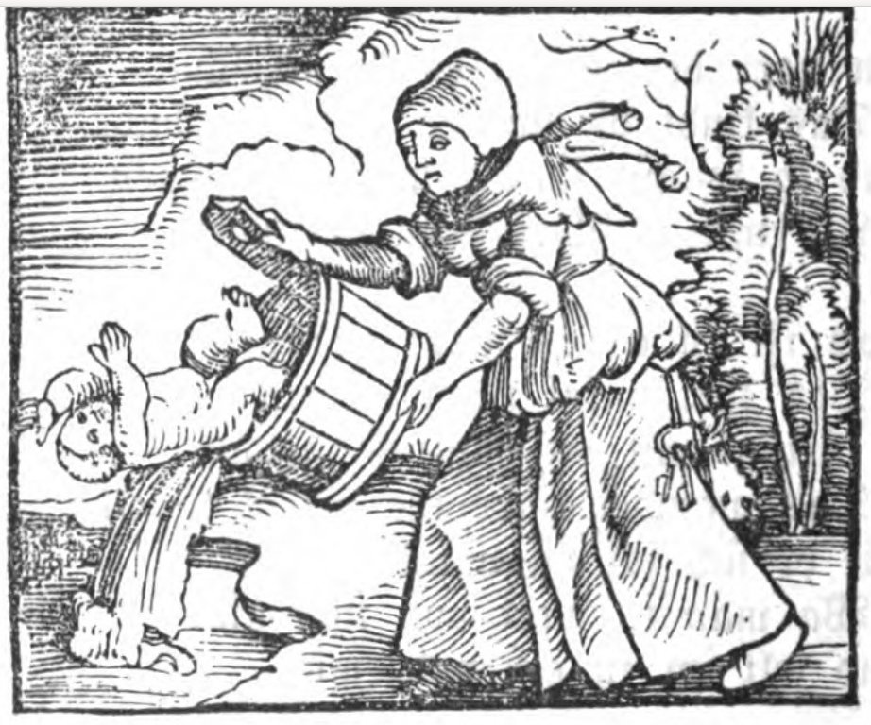
DRAM Industry: Throw the Baby Out with the Bathwater
TRR
Right question: How do we design a low-cost TRR that is provably secure?

Slide 13
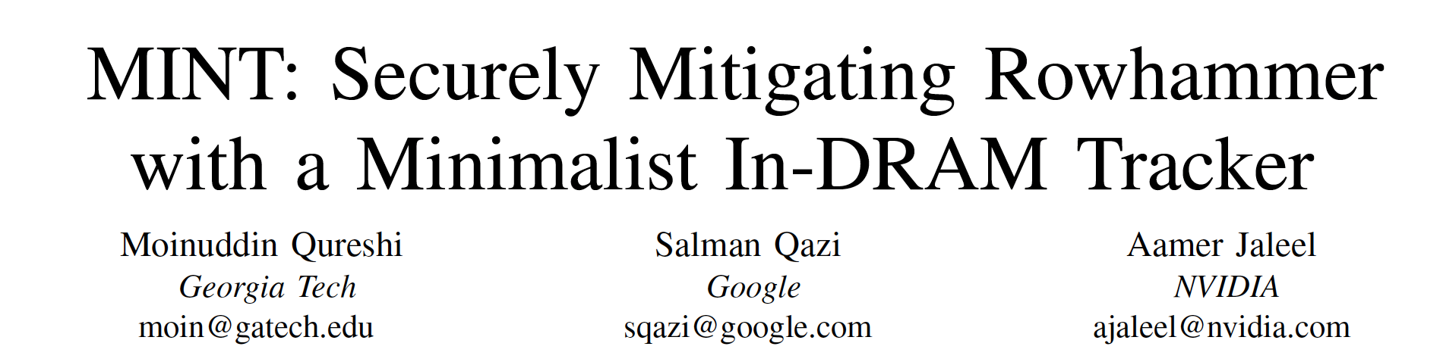
Outline
The Rowhammer Saga
MINT: Minimalist Randomized Tracker
MOAT: Secure Mitigation with PRAC
MoPAC: Reducing the Slowdown of PRAC
Parting Thoughts
MICRO-2024

Slide 14
Why In-DRAM Trackers Fail?
In-DRAM Trackers characterized as having N entries and managed by 3 policies
Insertion
Policy
In-DRAM Tracker
(Counters)
Mitigation
Policy
Eviction Policy
Three sources of failures:
Insertion Failure (target address not get inserted in tracker within TRH)
Retention Failure (the address was inserted but got evicted without mitigation)
Tardiness (more activations between insertion and mitigation breaching TRH)
Build trackers such that it is easy to reason about the worst-case patterns and the resulting tolerated threshold

Slide 15
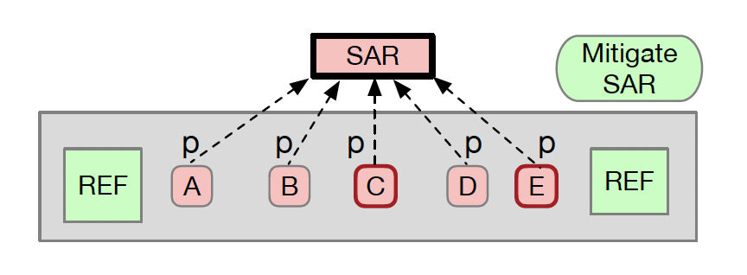
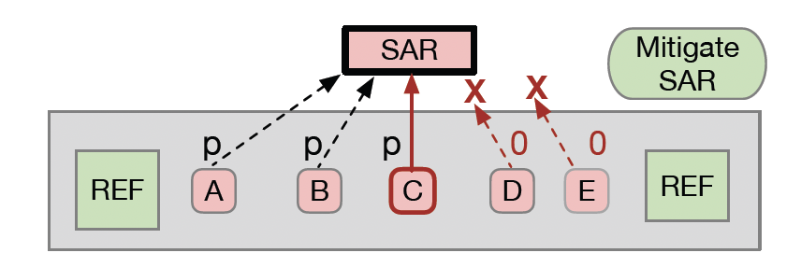
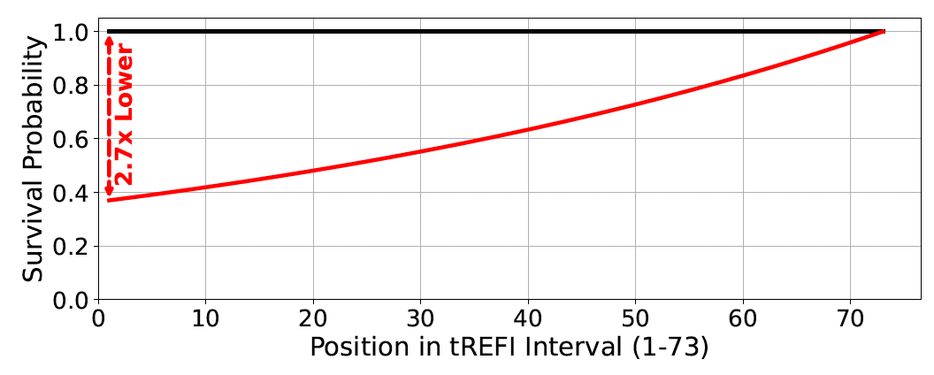
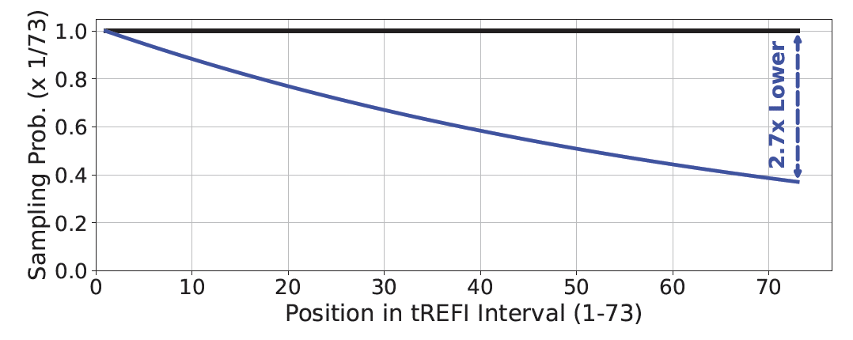
The Problem of Non-Uniform Mitigation
Observation: In-DRAM PARA (IID Tracking) has non-uniform mitigation
The non-uniform mitigation means attacker can focus on most vulnerable position

Slide 16
MINT: Minimalist In-DRAM Tracker
REF
REF
Window (can perform up to 73 ACT)
CAN=0
CAN=1
CAN=2
CAN=3
Which Row to Mitigate?
X = URAND (0,72) … LFSR
SAN=2
SAR
SAN: Selected Activation Num
CAN: Current Activation Num
SAR: Sampled Address Reg
MINT requires low hardware overhead (about 4 bytes)

Slide 17
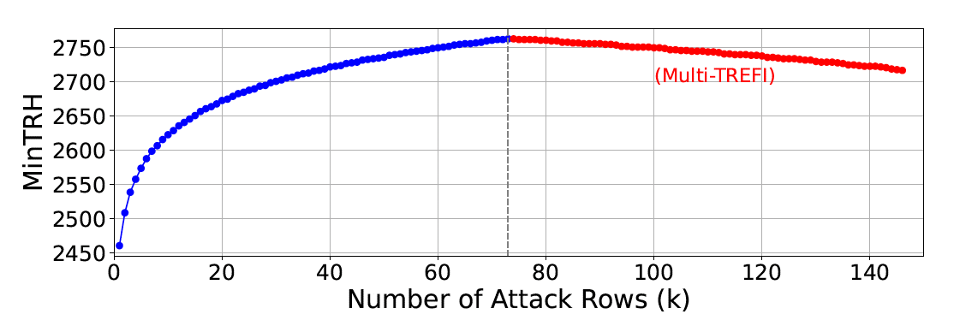
Deriving Worst-Case Pattern
What if we keep have 73 attack lines in the tREFI window? Failure probability becomes 73x
ABCDEF
ABCDEF
ABCDEF
ABCDEF
MINT has a TRH of 2800, TRH-D of 1400 (25% lower than PrIDE)
Outperforming 700-entry tracker with a single-entry!

Slide 18
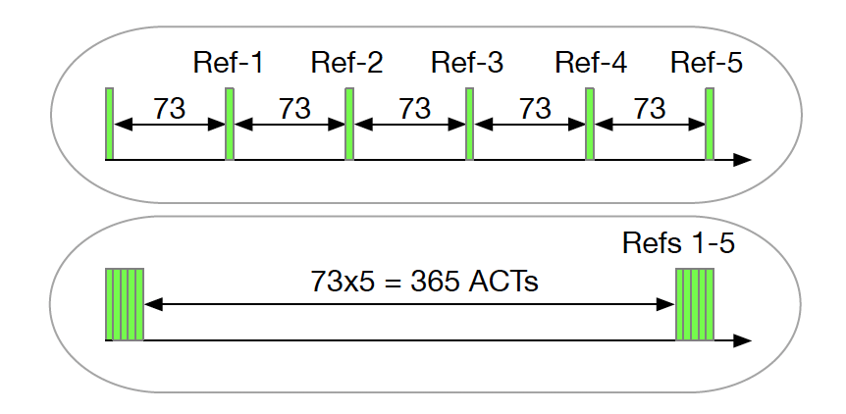
Refresh Postponement Attacks
Severity: Attacker can cause 478K unmitigated ACTs on a row!
(easy to tolerate with counter-based optimal trackers)
Refresh postponement breaks low-cost trackers

Slide 19
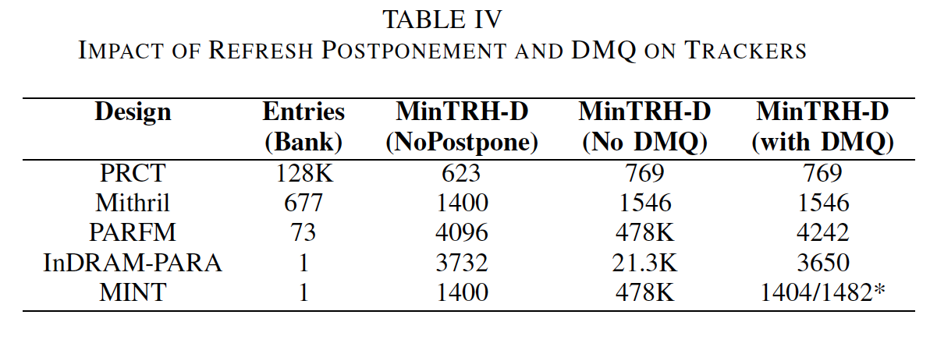
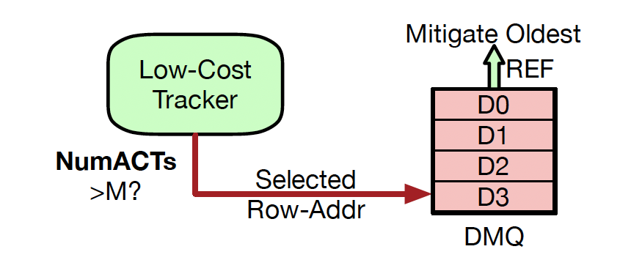
Delayed Mitigation Queue (DMQ)
Simple Solution to Refresh Postponement Attacks
MINT+DMQ: 1 Mitig per tREFI
TRH-D: 1480, Slowdown=0%
MINT+DMQ+RFM16
TRH-D: 356, Slowdown=1.6%
MINT+DMQ can tolerate a TRHD of 1482 (under Adaptive Attacks)
(within 2x of an idealized per-row tracker)

Slide 20
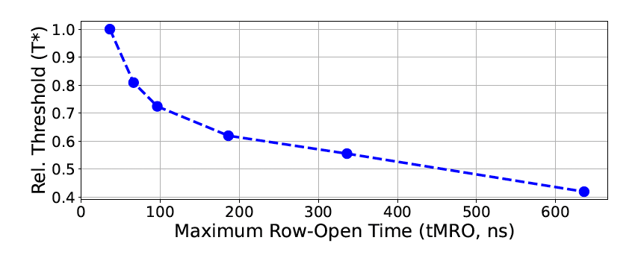
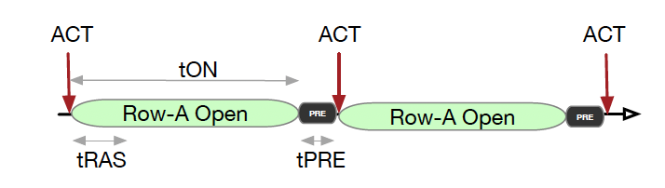
Row-Press: New Data-Disturbance Error
After ACT, neighbor row continue to leak charge on the bit line
Row-Press: Keep the row open for a long time!
[Luo, Mutlu, et al. ISCA-2023]
Row-Press cause bitflips with fewer ACTs, breaks all RH trackers

Slide 21
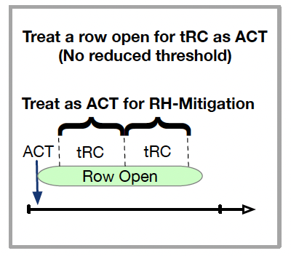
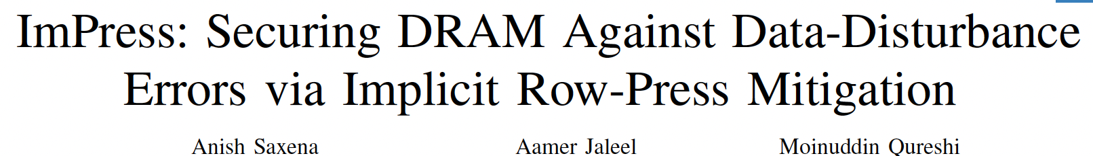
Insight
Tolerate Row-Press without affecting tolerated threshold
No artificial limit on tON (applicable to in-DRAM trackers)
Only minor impact on storage and performance overheads
MICRO-2024

Slide 22
Tolerating Row-Press with MINT?
Instead of incrementing CAN by 1 on ACT, increment by EACT
Select Row if CAN crosses SAN
REF
REF
Window (can perform up to 73 ACT)
SAN: Selected Activation Num
CAN: Current Activation Num
SAR: Sampled Address Reg
CAN=0
CAN=1.5
CAN=2.8
CAN=4
Which Row to Mitigate?
X = URAND (0,72) … LFSR
SAN=2
SAR
MINT+ImPress defends both RH and RP at ultra-low cost!

Slide 23
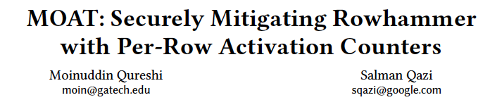
Outline
The Rowhammer Saga
MINT: Minimalist Randomized Tracker
MOAT: Secure Mitigation with PRAC
MoPAC: Reducing the Slowdown of PRAC
Parting Thoughts
ASPLOS-25

Slide 24
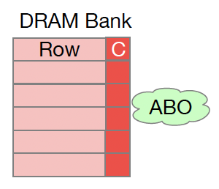
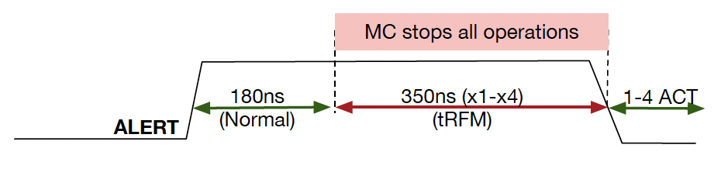
JEDEC Introduces PRAC+ABO
JEDEC: low-cost trackers broken, so let’s go for per-row tracking (space) and ABO (time)
PRAC: Per-Row-Activation-Counting, solves the space issue
ABO: Alert Back-off, solves the time issue
PRAC+ABO is a principled defense against RH (big changes to DRAM)

Slide 25
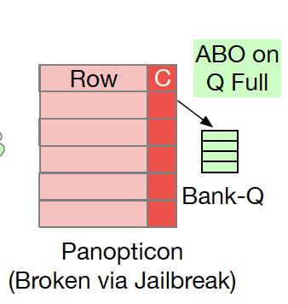
Panopticon Design
PRAC is a framework, does not specify implementation details, security depends on design
Typically, some SRAM needed to track which row(s) will get mitigated
Insert row in queue
if threshold bit flips
One aggressor-row mitigated every Nth REF
Trigger ALERT
if queue is full
(8 entry queue per-bank)
Panopticon: seminal work & inspiration behind PRAC and ABO

Slide 26
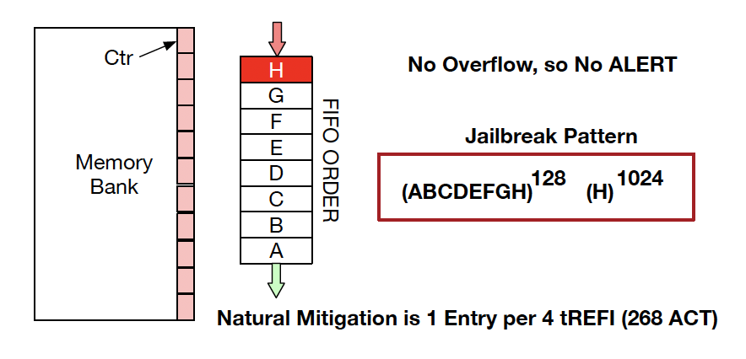
Exploiting Tardiness for Attack
E.g. Design does not track activations while the row is buffered in the queue
We can attack this design by filling the queue, and hammering the youngest row
Jailbreak inflicts 1150 ACTs on a row for design with threshold of 128

Slide 27
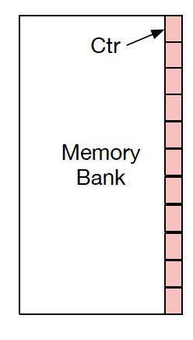
MOAT: Minimalist Provably Secure Design
Insight: Greedily track a single entry per bank (minimalist design, low SRAM cost)
ATH: ALERT Threshold determines TRH
On Access
PRAC.Ctr > CTA.Ctr?
Yes
Overwrite
CTA
On Access: if CTA.Ctr > ATH, trigger ALERT
On ALERT/Mitigative REF: mitigate CTA
Row Addr
Ctr
CTA: Currently Tracked Addr
MOAT is the first provably secure implementation for PRAC+ABO

Slide 28
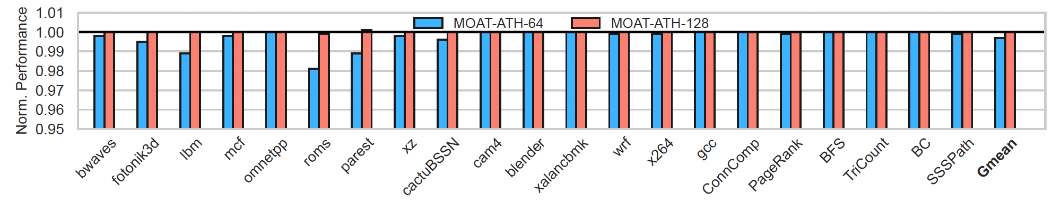
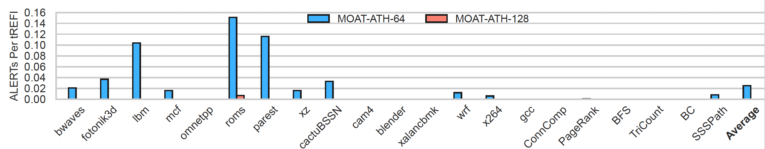
MOAT Overheads (norm. to PRAC)
The mitigation (ALERTs) from MOAT cause negligible performance overheads
MOAT with ATH = 128+ incurs virtually zero ALERTs

Slide 29
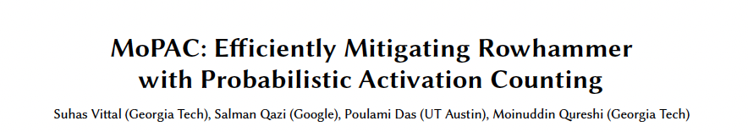
Outline
The Rowhammer Saga
MINT: Minimalist Randomized Tracker
MOAT: Secure Mitigation with PRAC
MoPAC: Reducing the Slowdown of PRAC
Parting Thoughts
ISCA-2025

Slide 30
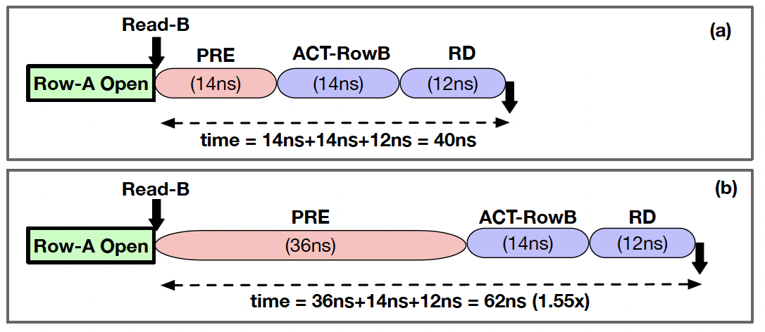
The Problem with PRAC
Two sources of slowdown: Intrinsic (inflated timing) + extrinsic (ABO related stalls)
PRAC suffers from high slowdown because of increased tRP/tRC (average 10% slowdown)
For row conflict, service time increases from 40ns to 62ns (1.5x)
For closed-page systems, tRC increase still significant (13%)

Slide 31
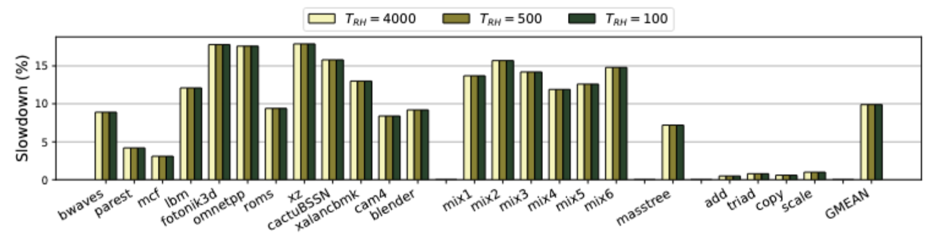
The Problem with PRAC
The high tRP and tRC causes significant slowdown (consistent with other studies)
Note: some prior studies showed 1% bus BW impact (BW != IPC)
If PRAC related slowdown is high, will the industry adopt PRAC?

Slide 32
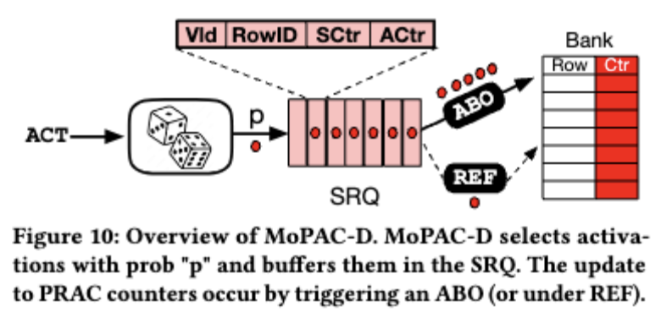
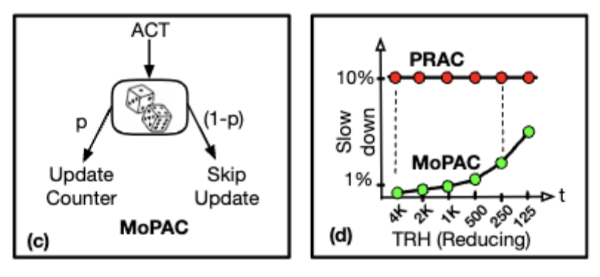
Insight: Are all counter updates necessary?
Instead of incrementing PRAC counter on each activation, update probabilistically
Revise ATH to account for sampling rate and sampling inefficiency
MOPAC uses REF for ctr updates (triggers ABO if buffer fills up)

Slide 33
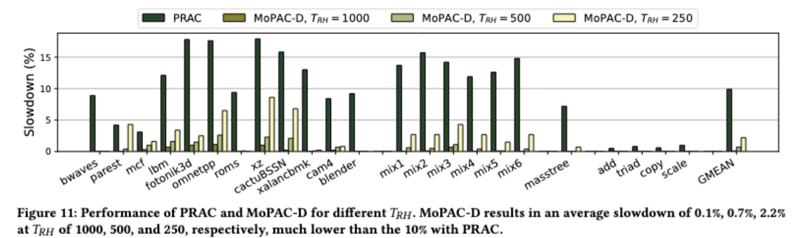
Performance Overhead with MoPAC
Unlike PRAC, MoPAC performance overhead depends on threshold
MoPAC reduces the PRAC slowdown from 10% to 0.1%-2.2%

Slide 34
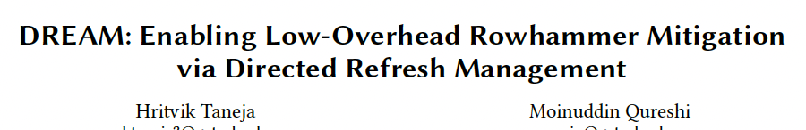
Outline
The Rowhammer Saga
MINT: Minimalist Randomized Tracker
MOAT: Secure Mitigation with PRAC
MoPAC: Reducing the Slowdown of PRAC
DREAM: MC-Side Mitigations with DRFM
Parting Thoughts
ISCA-2025

Slide 35



MC-Side Rowhammer Mitigation
Why?
ACT
Mitigate
Avoid obscure/proprietary DRAM TRR
Avoid slowdown of PRAC
Avoid reliance on REF cannibalization
Ensure security at low-cost in SOC
Memory Controller
TRHD | p
500 | 1/25
1000 | 1/50
2000 | 1/100
MC-based RH mitigation enables SOC vendors to ensure security

Slide 36
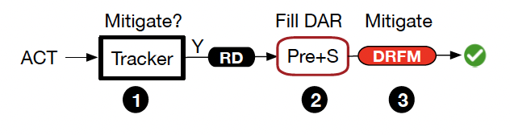
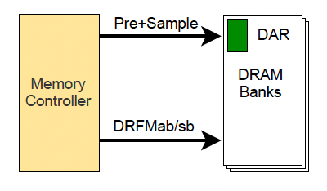
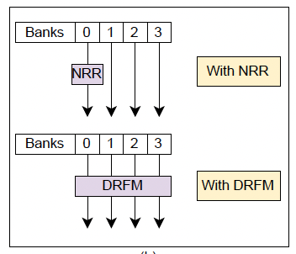
DRFM: DDR5 Support for Mitigation
DRFM stalls 8-32 banks for each mitigation, performance impact?

Slide 37
Slowdown from PARA with DRFM
Replacing NRR with DRFM causes significant slowdowns!

Slide 38
Insight: Delay Issuing DRFM
Concurrent
Mitigation
BANK 1
Pre+S
BANK 2
Pre+S
BANK 3
Pre+S
BANK 1
BANK 2
BANK 3
How long should we delay?
Delay until the next the next sampled row to the same bank
Delaying gives other banks chance to sample into DAR

Slide 39
DRFM Aware Mitigation (DREAM)
DREAM has much lower slowdown than PRAC at current TRH
MC-Side mitigation are quite useful (vs PRAC) for SOC vendors

Slide 40
Outline
The Rowhammer Saga
MINT: Minimalist Randomized Tracker
MOAT: Secure Mitigation with PRAC
MoPAC: Reducing the Slowdown of PRAC
DREAM: MC-Side Mitigations with DRFM
Parting Thoughts

Slide 41
Painting vs. Sculpture

Slide 42
Conclusion
Even after a decade, DRAM industry is unable to solve Rowhammer
Don’t throw TRR away – it is the lowest cost solution. Make it secure.
PRAC still needs to be carefully architected to ensure security
PRAC has high slowdown, need to reduce it for practical adoption
SOC vendors can take matters in their hand with DRFM, still useful for DDR6
Minimalism is key to ensuring security!
Performance matters: Everyone wants security, no one wants to pay

